Slide 1
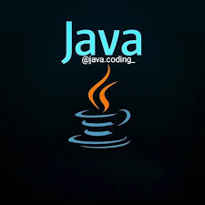
JAVA ARCHITECTURE
BY: JOSEFIN J

Slide 2
JAVA ARCHITECTURE
Java Architecture is a collection of components, i.e.,
JVM
JRE
JDK
It integrates the process of interpretation and compilation. It defines all the processes involved in creating a Java program.
Java Architecture explains each and every step of how a program is compiled and executed.

Slide 3
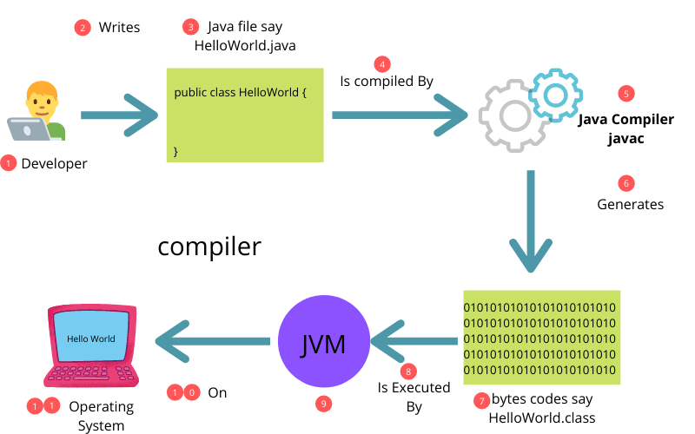
COMPONENTS OF ARCHITECTURE

Slide 4
JAVA DEVELOPMENT KIT (JDK)
It is a software development environment used in the development of Java applications and applets.
Java Development Kit holds JRE, a compiler, an interpreter or loader, and several development tools in it.

Slide 5
JAVA VIRTUAL MACHINE(JVM)
The main feature of Java is WORA. WORA stands for Write Once Run Anywhere.
The feature states that we can write our code once and use it anywhere or on any operating system.
Our Java program can run any of the platforms only because of the Java Virtual Machine.
It is a Java platform component that gives us an environment to execute java programs.
JVM's main task is to convert byte code into machine code.

Slide 6
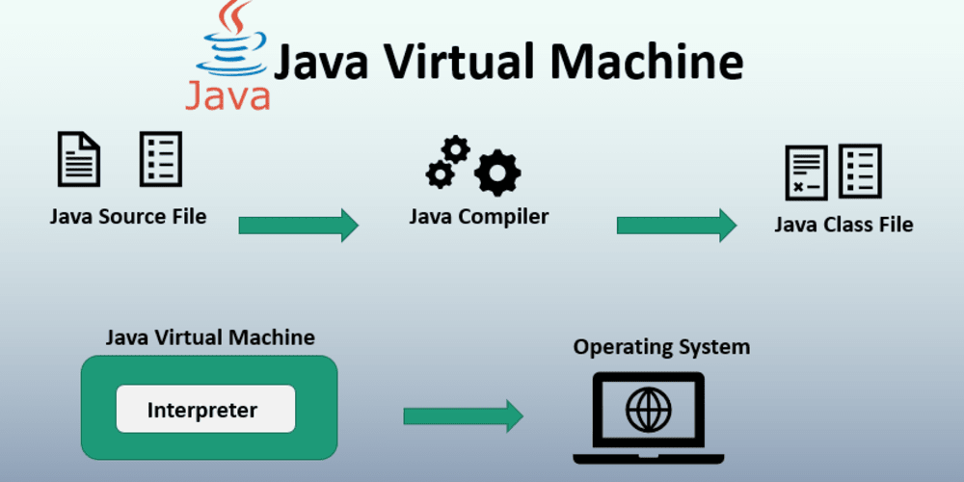
JVM ARCHITECTURE

Slide 7
JAVA SOURCE FILE:
A Java source file is a text file with a `.java` extension that contains Java code.
It is written in a human-readable format and defines classes and methods. When compiled using the Java Compiler (`javac`), it is converted into bytecode, which is stored in `.class` files. The Java Virtual Machine (JVM) then executes this bytecode, enabling the program to run on any platform with a compatible JVM. This process supports Java's "write once, run anywhere" capability.
JAVA COMPILER:
The Java Compiler, known as `javac`, is a tool that translates Java source files (with a `.java` extension) into bytecode (stored in `.class` files).
This bytecode is an intermediate representation that the Java Virtual Machine (JVM) can execute. The compiler checks for syntax errors and enforces language rules, ensuring the source code is valid before converting it to bytecode, which allows for platform-independent execution of Java applications.

Slide 8
JAVA CLASS FILE:
A Java class file is a binary file with a `.class` extension that contains bytecode generated by the Java Compiler (`javac`).
This bytecode is an intermediate representation of the Java source code, designed to be executed by the Java Virtual Machine (JVM). The class file includes metadata about the class, methods, and fields, enabling the JVM to load, link, and execute the program across different platforms.
INTERPRETER:
In the Java Virtual Machine (JVM), an interpreter is a component that reads and executes bytecode directly, translating it into machine code instruction by instruction.
This allows Java programs to run without prior compilation to native code.
The interpreter provides flexibility and quick startup times, but can be slower than Just-In-Time (JIT) compilation, which optimizes frequently executed code into native machine code for better performance.

Slide 9
OPERATING SYSTEM:
In the context of the Java Virtual Machine (JVM), the operating system (OS) serves as the underlying platform that manages hardware resources and provides essential services to applications, including the JVM.
The JVM runs on top of the OS, relying on it for tasks like memory management, file handling, and process scheduling. This allows Java applications to be executed in a consistent environment across different operating systems, supporting the "write once, run anywhere" capability of Java.

Slide 10
JAVA RUNTIME ENVIRONMENT(JRE)
It provides an environment in which Java programs are executed.
JRE takes our Java code, integrates it with the required libraries, and then starts the JVM to execute it.

Slide 11


